Slide 1
SECURE DATA HIDING IN IMAGES USING STEGANOGRAPHY
CAPSTONE PROJECT
Presented By:
Student Name : MD ARBAZ
College Name & Department : NAWAB SHAH ALAM KHAN COLLEGE OF ENGINERRING & CSE(CYBERSECURITY,IOT & BLOCKCHAIN)

Slide 2
OUTLINE
Problem Statement
Technology used
Wow factor
End users
Result
Conclusion
Git-hub Link
Future scope

Slide 3
Problem Statement
Securely hiding a secret message inside an image without making it visibly suspicious is a common problem in data security. Traditional methods often leave traces that can be detected. This project aims to encrypt a message inside an image pixel-by-pixel, improving confidentiality. It ensures that only people with the correct passcode can decrypt the hidden message. This adds an extra layer of protection to sensitive communications.

Slide 4
Technology used
The project uses Python programming language for implementing the logic. OpenCV library (cv2) is used for image processing and manipulation. Basic concepts of ASCII encoding and pixel value modification are applied. Operating system commands are used to open files after encryption. The project demonstrates a simple but effective steganography technique.

Slide 5
Wow factors
The encryption embeds the message directly into pixel values without noticeably altering the image. Decryption is protected by a user-defined password, ensuring that unauthorized users cannot retrieve the message. It dynamically shifts between RGB channels to avoid predictable patterns. The method is simple yet powerful for small-scale secure communications. Real-time decryption validation makes it feel secure and interactive.

Slide 6
End users
This project can be used by individuals who want to privately exchange messages. Students and researchers learning about cryptography and steganography can find it very useful. Journalists and activists requiring secure communication channels can benefit from it. Hobbyists and programmers interested in security projects can also implement it. In general, anyone interested in data privacy could be an end user.

Slide 7
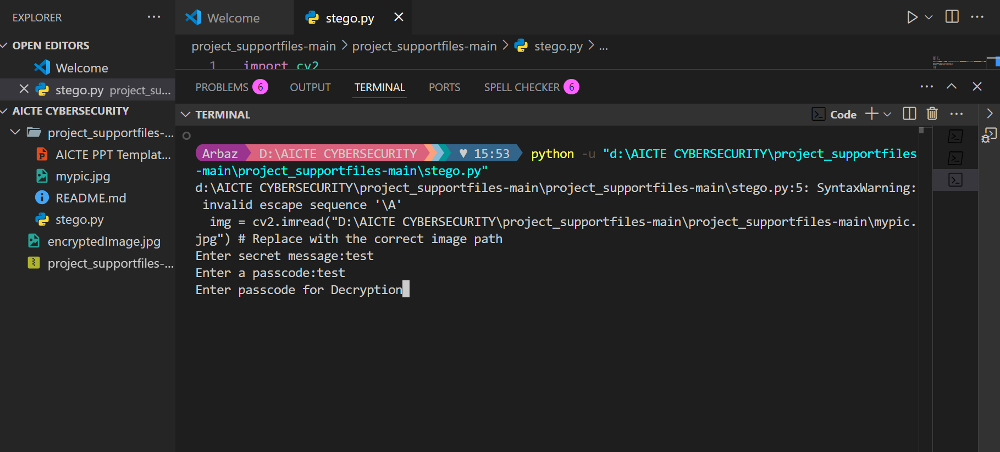
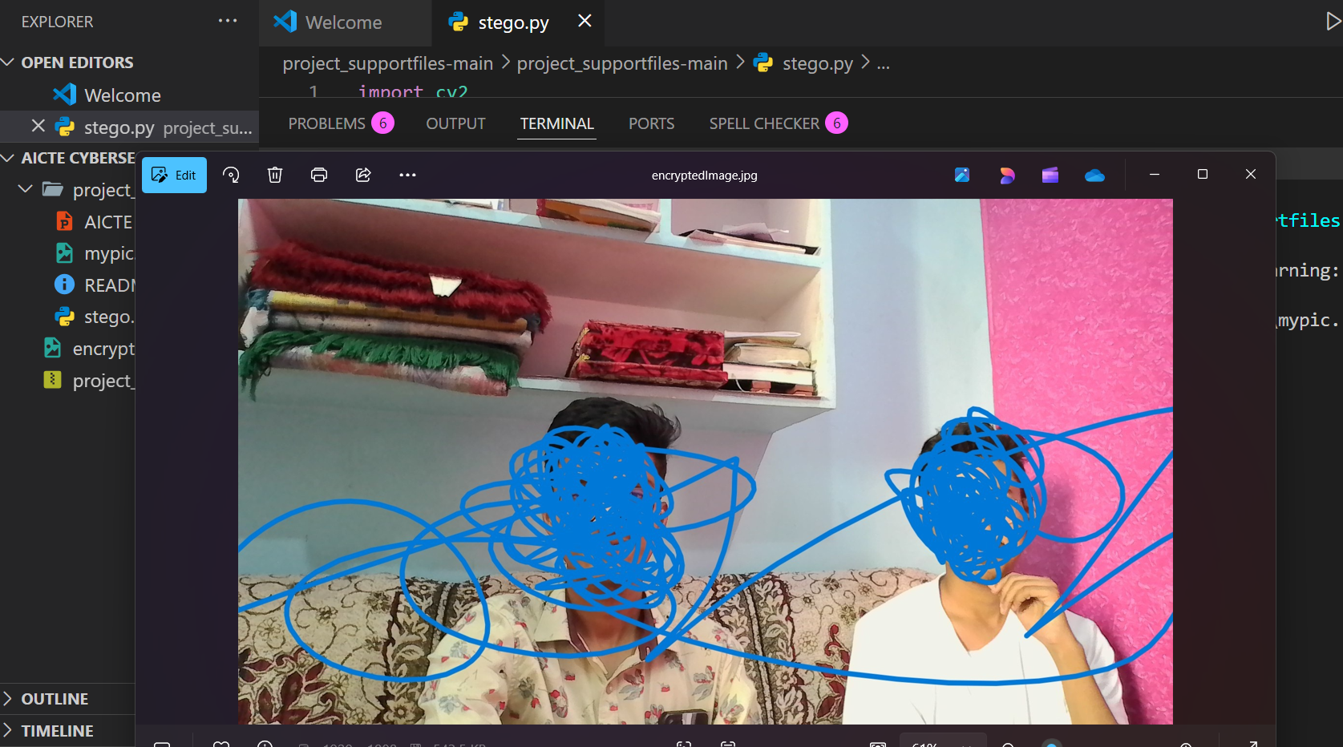
Results

Slide 8
Conclusion
The project demonstrates how simple techniques can be used for effective data hiding in images. It emphasizes the importance of passwords in maintaining data confidentiality. The approach balances simplicity and security, making it accessible for beginners. It highlights how pixel manipulation can be used creatively beyond traditional image editing. Overall, it proves to be an excellent introduction to steganography concepts.

Slide 9
GitHub Link
Make sure that there should be readme file

Slide 10
THANK YOU

